Slide 1

HUMAN RESOURCE MANAGEMENT
Global Edition 12e
Chapter 5
Personnel Planning and Recruiting
Part 2 Recruitment and Placement
Copyright © 2011 Pearson Education
GARY DESSLER
PowerPoint Presentation by Charlie Cook
The University of West Alabama
Notes:
Human Resources Management 12e
Gary Dessler
Copyright © 2011 Pearson Education
1–<number>

Slide 2

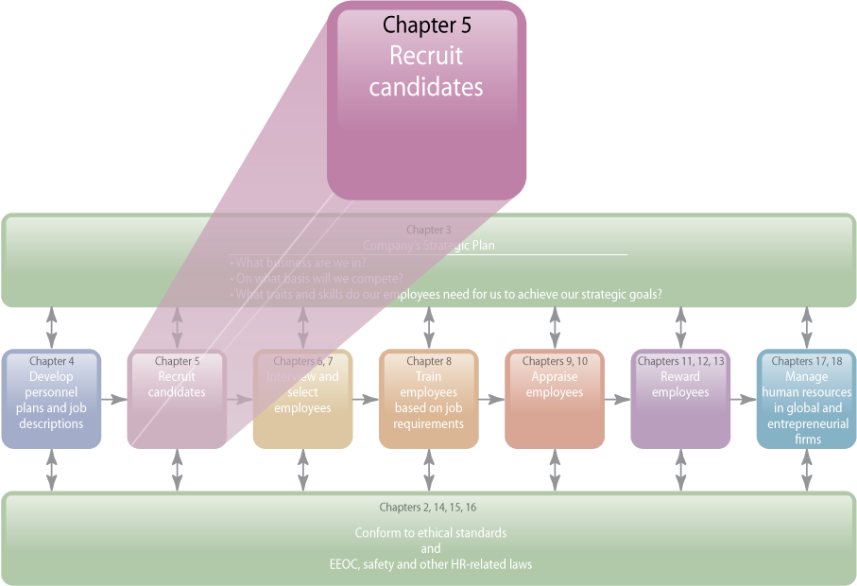
WHERE WE ARE NOW…
Copyright © 2011 Pearson Education
5–<number>
Notes:
Human Resources Management 12e
Gary Dessler
Copyright © 2011 Pearson Education
5–<number>
In Chapter 4, we discussed job analysis and the methods managers use to create job descriptions and job specifications. The purpose of this chapter is to improve your effectiveness in recruiting candidates. The topics we discuss include personnel planning and forecasting, recruiting job candidates, and developing and using application forms.
Then, in Chapter 6, we’ll turn to the methods managers use to select the best employees from this applicant pool.

Slide 3
LEARNING OUTCOMES
List the steps in the recruitment and selection process.
Explain the main techniques used in employment planning and forecasting.
Explain and give examples for the need for effective recruiting.
Name and describe the main internal sources of candidates.
List and discuss the main outside sources of candidates.
Develop a help wanted ad.
Explain how to recruit a more diverse workforce.
Copyright © 2011 Pearson Education
5–<number>
Notes:
Human Resources Management 12e
Gary Dessler
Copyright © 2011 Pearson Education
5–<number>

Slide 4
The Recruitment and Selection Process
Decide what positions to fill through personnel planning and forecasting.
Build a candidate pool by recruiting internal or external candidates.
Have candidates complete application forms and undergo initial screening interviews.
Use selection tools to identify viable candidates.
Decide who to make an offer to, by having the supervisor and others interview the candidates.
Copyright © 2011 Pearson Education
5–<number>
Notes:
Human Resources Management 12e
Gary Dessler
Copyright © 2011 Pearson Education
5–<number>
Job analysis identifies the duties and human requirements for each of the company’s jobs. The next step is to decide how many of these jobs you need to fill, and to recruit and select employees for them.

Slide 5
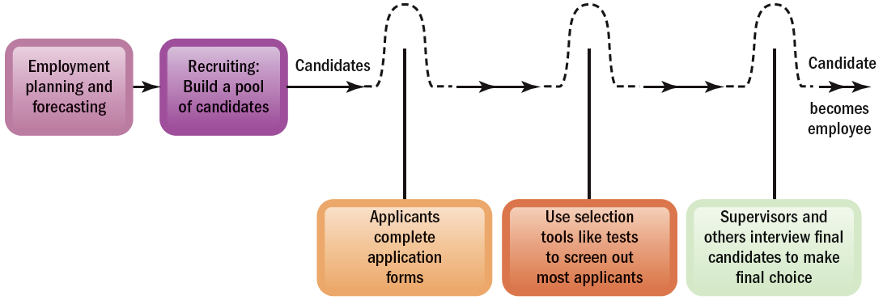
FIGURE 5–1 Steps in Recruitment and Selection Process
The recruitment and selection process is a series of hurdles aimed at selecting the best candidate for the job.
Copyright © 2011 Pearson Education
5–<number>
Notes:
Human Resources Management 12e
Gary Dessler
Copyright © 2011 Pearson Education
5–<number>
The best way to envision recruitment and selection is as a series of hurdles as shown in Figure 5-1.

Slide 6
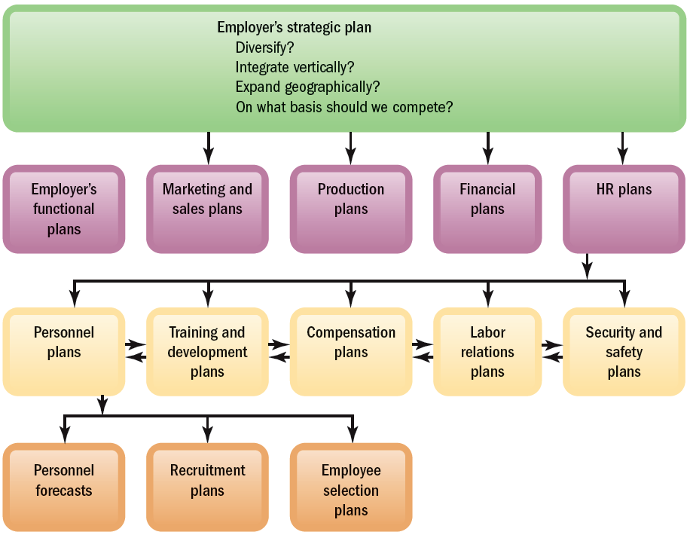
FIGURE 5–2 Linking Employer’s Strategy to Plans
Copyright © 2011 Pearson Education
5–<number>
Notes:
Human Resources Management 12e
Gary Dessler
Copyright © 2011 Pearson Education
5–<number>
Employment planning should flow from the firm’s strategic plans. Figure 5-2 summarizes the link between strategic and personnel planning.

Slide 7

Planning and Forecasting
Employment or Personnel Planning
  The process of deciding what positions
  the firm will have to fill, and how to fill them.
Succession Planning
  The process of deciding how to fill the company’s most important executive jobs.
What to Forecast?
  Overall personnel needs
  The supply of inside candidates
  The supply of outside candidates
Copyright © 2011 Pearson Education
5–<number>
Notes:
Human Resources Management 12e
Gary Dessler
Copyright © 2011 Pearson Education
5–<number>
Employment (or personnel) planning is the process of deciding what positions the firm will have to fill, and how to fill them. It embraces all future positions, from maintenance clerk to CEO. However, most firms call the process of deciding how to fill executive jobs succession planning.
Like all good plans, personnel plans require some forecasts or estimates, in this case, of three things: personnel needs, the supply of inside candidates, and the likely supply of outside candidates.

Slide 8
Forecasting Personnel Needs
Forecasting Tools
Trend analysis
Ratio analysis
Scatter plotting
Copyright © 2011 Pearson Education
5–<number>
Notes:
Human Resources Management 12e
Gary Dessler
Copyright © 2011 Pearson Education
5–<number>
Trend analysis can provide an initial estimate of future staffing needs, but employment levels rarely depend just on the passage of time. Other factors (like changes in sales volume and productivity) also affect staffing needs.
Ratio analysis provides forecasts based on the historical ratio between (1) some causal factor (like sales volume) and (2) the number of employees required (such as number of salespeople).
A scatter plot shows graphically how two variables—such as sales and your firm’s staffing levels—are related. If they are, and then if you can forecast the business activity (like sales), you should also be able to estimate your personnel needs.

Slide 9
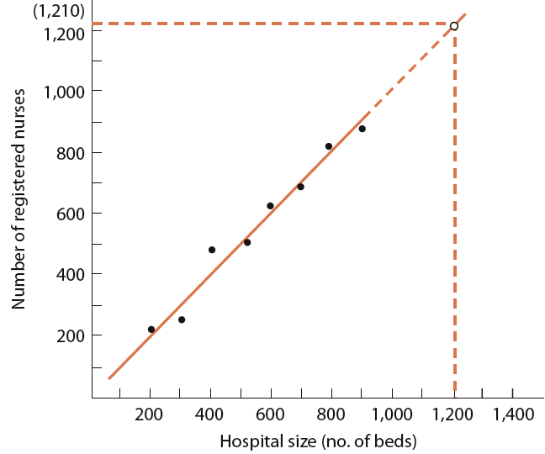
FIGURE 5–3 Determining the Relationship Between
Hospital Size and Number of Nurses
Hospital Size (Number of Beds) | Number of Registered Nurses
200 | 240
300 | 260
400 | 470
500 | 500
600 | 620
700 | 660
800 | 820
900 | 860
Note: After fitting the line, you can project how many employees are needed, given your projected volume.
Copyright © 2011 Pearson Education
5–<number>
Notes:
Human Resources Management 12e
Gary Dessler
Copyright © 2011 Pearson Education
5–<number>
Figure 5-3 shows hospital size on the horizontal axis. It shows number of nurses on the vertical axis. If these two factors are related, then the points will tend to fall along a straight line, as they do here. If you carefully draw in a line to minimize the distances between the line and each one of the plotted points, you will be able to estimate the number of nurses needed for each hospital size. Thus, for a 1,200-bed hospital, the human resource director would assume she needs about 1,210 nurses.

Slide 10
Drawbacks to Traditional Forecasting Techniques
They focus on projections and historical relationships.
They do not consider the impact of strategic initiatives on future staffing levels.
They support compensation plans that reward managers for managing ever-larger staffs.
They “bake in” the idea that staff increases are inevitable.
They validate and institutionalize present planning processes and the usual ways of doing things.
Copyright © 2011 Pearson Education
5–<number>
Notes:
Human Resources Management 12e
Gary Dessler
Copyright © 2011 Pearson Education
5–<number>
Managers obviously need to consider other factors too. These include projected turnover, decisions to upgrade (or downgrade) products or services, productivity changes, and financial resources.

Slide 11
Using Computers to Forecast Personnel Requirements
Computerized Forecasts
  Software that estimates future staffing needs by:
    Projecting sales, volume of production, and personnel required to maintain different volumes of output.
    Forecasting staffing levels for direct labor, indirect staff, and exempt staff.
    Creating metrics for direct labor hours and three sales projection scenarios—minimum, maximum, and probable.
Copyright © 2011 Pearson Education
5–<number>
Notes:
Human Resources Management 12e
Gary Dessler
Copyright © 2011 Pearson Education
5–<number>
Computerized forecasts enable the manager to build more variables into his or her personnel projections. Newer systems particularly rely on mathematically setting clear goals.
Whichever forecasting tool you use, managerial judgment should play a big role. It’s rare that any historical trend, ratio, or relationship will simply continue. You will therefore have to modify the forecast based on subjective factors—such as the feeling that more employees will be quitting—you believe will be important.

Slide 12
Forecasting the Supply of Inside Candidates
Qualification Inventories
Manual systems and replacement charts
Computerized skills inventories
Copyright © 2011 Pearson Education
5–<number>
Notes:
Human Resources Management 12e
Gary Dessler
Copyright © 2011 Pearson Education
5–<number>
Knowing your staffing needs satisfies only half the staffing equation. Next, you have to estimate the likely supply of both inside and outside candidates. Most firms start with the inside candidates.
Department managers or owners of smaller firms often use manual devices to track employee qualifications. Thus a personnel inventory and development record form compiles qualifications information on each employee.
Computerized skills inventory data typically include items like work experience codes, product knowledge, the employee’s level of familiarity with the employer’s product lines or services, the person’s industry experience, and formal education.

Slide 13

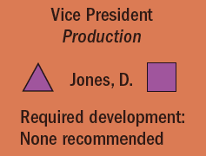
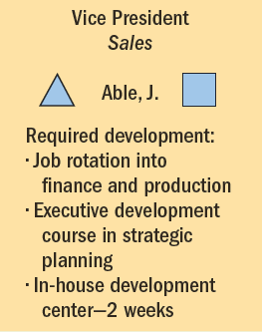
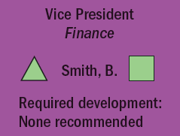
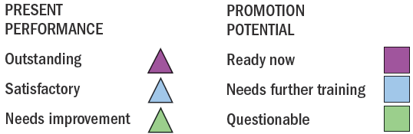
FIGURE 5–4 Management Replacement Chart Showing Development Needs of Potential Future Divisional Vice Presidents
Copyright © 2011 Pearson Education
5–<number>
Notes:
Human Resources Management 12e
Gary Dessler
Copyright © 2011 Pearson Education
5–<number>
Figure 5-4 is a personnel replacement chart for some of a firm’s top positions. It shows the present performance and promotability for each position’s potential replacement.

Slide 14
The Matter of Privacy
Ensuring the Security of HR Information
  Control of HR information through access matrices
  Access to records and employee privacy
Legal Considerations
  The Federal Privacy Act of 1974
  New York Personal Privacy Act of 1985
  HIPAA
  Americans with Disabilities Act
Copyright © 2011 Pearson Education
5–<number>
Notes:
Human Resources Management 12e
Gary Dessler
Copyright © 2011 Pearson Education
5–<number>
The employer should secure all its employee data. Much of the data is personal (such as Social Security numbers and illnesses). Legislation gives employees legal rights regarding who has access to information about them.

Slide 15
Forecasting Outside Candidate Supply
Factors In Supply of Outside Candidates
  General economic conditions
  Expected unemployment rate
Sources of Information
  Periodic forecasts in business publications
  Online economic projections
    U.S. Congressional Budget Office (CBO)
    U.S. Department of Labor’s O*NET™
    Bureau of Labor Statistics (BLS)
    Other federal agencies and private sources
Copyright © 2011 Pearson Education
5–<number>
Notes:
Human Resources Management 12e
Gary Dessler
Copyright © 2011 Pearson Education
5–<number>
If there won’t be enough inside candidates to fill the anticipated openings (or you want to go outside for another reason), you will turn to outside candidates.

Slide 16
The Need for Effective Recruiting
Recruiting Challenges
Effectiveness of chosen recruiting methods
Effects of nonrecruitment issues and policies
Legal requirements associated with employment laws
Copyright © 2011 Pearson Education
5–<number>
Notes:
Human Resources Management 12e
Gary Dessler
Copyright © 2011 Pearson Education
5–<number>
It’s hard to overemphasize the importance of effective recruiting. It’s easy to assume that recruiting is easy—that all you need do is place a few ads on the Web. Nothing could be farther from the truth. Several things make it more complex.

Slide 17
Effective Recruiting
External Factors Affecting Recruiting
  Supply of workers
  Outsourcing of white-collar jobs
  Fewer “qualified” candidates
Other Factors Affecting Recruiting Success
  Consistency of recruitment with strategic goals
  Types of jobs recruited and recruiting methods
  Nonrecruitment HR issues and policies
  Successful prescreening of applicants
  Public image of the firm
  Employment laws
Copyright © 2011 Pearson Education
5–<number>
Notes:
Human Resources Management 12e
Gary Dessler
Copyright © 2011 Pearson Education
5–<number>
Assuming the company authorizes you to fill a position, the next step is to build up, through recruiting, an applicant pool. Employee recruiting means finding and/or attracting applicants for the employer’s open positions.

Slide 18
Organizing How You Recruit
Advantages of Centralizing Recruiting Efforts
Facilitates strategic priorities
Reduces duplication of HR activities
Ensures compliance with EEO laws
Fosters effective use of online recruiting
Copyright © 2011 Pearson Education
5–<number>
Notes:
Human Resources Management 12e
Gary Dessler
Copyright © 2011 Pearson Education
5–<number>
Should you centralize your firm’s recruitment efforts, or let each plant or office do their own recruiting? Reasons for doing so appear on this slide.

Slide 19
Measuring Recruiting Effectiveness
Evaluating Recruiting Effectiveness
What to measure
How to
measure
Copyright © 2011 Pearson Education
5–<number>
Notes:
Human Resources Management 12e
Gary Dessler
Copyright © 2011 Pearson Education
5–<number>
Measuring recruiting effectiveness requires deciding what recruiting outcomes to measure and how to measure them.

Slide 20
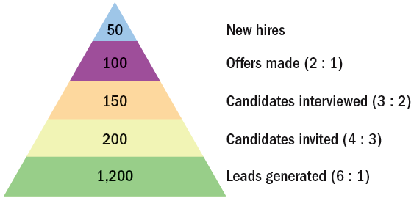
FIGURE 5–6 Recruiting Yield Pyramid
●
50% ● ●
67% ● ● ●
75% ● ● ● ●
16% ● ● ● ● ● ●
Copyright © 2011 Pearson Education
5–<number>
Notes:
Human Resources Management 12e
Gary Dessler
Copyright © 2011 Pearson Education
5–<number>
Figure 5-6 illustrates an example of an employer’s use of a recruiting yield pyramid to calculate the number of applicants they must generate to hire the required number of new employees.

Slide 21
Internal Sources of Candidates
Advantages
Disadvantages
Foreknowledge of candidates’ strengths
and weaknesses
More accurate view of candidate’s skills
Candidates have a stronger commitment
to the company
Increases employee morale
Less training and orientation required
Failed applicants become discontented
Time wasted interviewing inside candidates who will not be considered
Inbreeding strengthens tendency to maintain the status quo
Copyright © 2011 Pearson Education
5–<number>
Notes:
Human Resources Management 12e
Gary Dessler
Copyright © 2011 Pearson Education
5–<number>
Recruiting of current employees, or “hiring from within,” is often the best source of candidates. However, there are advantages and disadvantages to using internal candidates.

Slide 22
Finding Internal Candidates
Hiring-from-Within Tasks
Posting open
job positions
Rehiring former employees
Succession
planning (HRIS)
Copyright © 2011 Pearson Education
5–<number>
Notes:
Human Resources Management 12e
Gary Dessler
Copyright © 2011 Pearson Education
5–<number>
Hiring from within ideally relies on job posting and the firm’s skills inventories. Job posting means publicizing the open job to employees (usually by literally posting it on company intranets or bulletin boards). These postings list the job’s attributes, like qualifications, supervisor, work schedule, and pay rate.
Qualifications skills banks also play a role. For example, the database may reveal persons who have potential for further training or who have the right background for the open job.

Slide 23
Outside Sources of Candidates
Locating Outside Candidates
1
Recruiting via the Internet
6
Executive Recruiters
2
Advertising
7
On Demand Recruiting Services (ODRS)
3
Employment Agencies
8
College Recruiting
4
Temp Agencies and Alternative Staffing
9
Referrals and Walk-ins
5
Offshoring/Outsourcing
Copyright © 2011 Pearson Education
5–<number>
Notes:
Human Resources Management 12e
Gary Dessler
Copyright © 2011 Pearson Education
5–<number>
Firms can’t always get all the employees they need from their current staff, and sometimes they just don’t want to. This slide lists some of the sources that firms use to find outside candidates.

Slide 24

FIGURE 5–7 Some Top Online Recruiting Job Boards
Copyright © 2011 Pearson Education
5–<number>
Notes:
Human Resources Management 12e
Gary Dessler
Copyright © 2011 Pearson Education
5–<number>
Most people today go online to look for jobs. For most employers and for most jobs, Internet-based recruiting is by far the recruiting source of choice. Most employers recruit through their own Web sites, or use job boards. Figure 5-7 highlights some top online recruiting job boards.

Slide 25
Recruiting via the Internet
Advantages
    Cost-effective way to publicize job openings
    More applicants attracted over a longer period
    Immediate applicant responses
    Online prescreening of applicants
    Links to other job search sites
    Automation of applicant tracking and evaluation
Disadvantages
    Exclusion of older and minority workers
    Unqualified applicants overload the system
    Personal information privacy concerns of applicants
Copyright © 2011 Pearson Education
5–<number>
Notes:
Human Resources Management 12e
Gary Dessler
Copyright © 2011 Pearson Education
5–<number>
Internet recruiting is a cost-effective way to publicize openings; it generates more responses quicker and for a longer time at less cost than just about any other method. However, Internet recruiting can present problems such as discrimination, application overload, and privacy.

Slide 26

FIGURE 5–8 Ineffective and Effective Web Ads
Copyright © 2011 Pearson Education
5–<number>
Notes:
Human Resources Management 12e
Gary Dessler
Copyright © 2011 Pearson Education
5–<number>
The best Web ads don’t just transpose newspaper ads to the Web. Figure 5-8 shows both an example of an ineffectively recycled print ad and an effective Web ad.

Slide 27
Advertising for Outside Candidates
The Media Choice
  Selection of the best medium depends on the positions for which the firm is recruiting.
    Newspapers: local and specific labor markets
    Trade and professional journals: specialized employees
    Internet job sites: global labor markets
Constructing (Writing) Effective Ads
  Create attention, interest, desire, and action (AIDA).
  Create a positive impression (image) of the firm.
Copyright © 2011 Pearson Education
5–<number>
Notes:
Human Resources Management 12e
Gary Dessler
Copyright © 2011 Pearson Education
5–<number>
While Web-based recruiting is rapidly replacing help wanted ads, a glance at almost any paper or business or professional magazine will confirm that print ads are still popular. To use help wanted ads successfully, employers have to address two issues: the advertising medium and the ad’s construction.

Slide 28

FIGURE 5–9 Help Wanted Ad that Draws Attention
Copyright © 2011 Pearson Education
5–<number>
Notes:
Human Resources Management 12e
Gary Dessler
Copyright © 2011 Pearson Education
5–<number>
Figure 5-9 shows an ad from one classified section. Why does this ad attract attention? The phrase “next key player” certainly helps. Employers usually advertise key positions in display ads like this.

Slide 29
Employment Agencies
Types of Employment Agencies
Public
agencies
Nonprofit
agencies
Private
agencies
Copyright © 2011 Pearson Education
5–<number>
Notes:
Human Resources Management 12e
Gary Dessler
Copyright © 2011 Pearson Education
5–<number>
There are three main types of employment agencies: (1) public agencies operated by federal, state, or local governments; (2) agencies associated with nonprofit organizations; and (3) privately owned agencies.

Slide 30
Why Use a Private Employment Agency?
No HR department: firm lacks recruiting and screening capabilities to attract a pool of qualified applicants.
To fill a particular opening quickly.
To attract more minority or female applicants.
To reach currently employed individuals who are more comfortable dealing with agencies than competing companies.
To reduce internal time devoted to recruiting.
Copyright © 2011 Pearson Education
5–<number>
Notes:
Human Resources Management 12e
Gary Dessler
Copyright © 2011 Pearson Education
5–<number>
Private employment agencies are important sources of clerical, white-collar, and managerial personnel. They charge fees (set by state law and posted in their offices) for each applicant they place. Most are “fee-paid” jobs, in which the employer pays the fee.

Slide 31
Avoiding Problems with
Employment Agencies
Give agency an accurate and complete job description.
Make sure tests, application blanks, and interviews are part of the agency’s selection process.
Review candidates accepted or rejected by your firm or the agency for effectiveness and fairness of agency’s screening process.
Screen agency for effectiveness in filling positions.
Supplement the agency’s reference checking by checking the final candidate’s references yourself.
Copyright © 2011 Pearson Education
5–<number>
Notes:
Human Resources Management 12e
Gary Dessler
Copyright © 2011 Pearson Education
5–<number>
Using employment agencies requires avoiding potential pitfalls. For example, the employment agency’s screening may let poor applicants go directly to the supervisors responsible for hiring, who may in turn naively hire them. Conversely, improper screening at the agency could block potentially successful applicants.

Slide 32
Specialized Staffing and Recruiting
Alternative Staffing
  In-house contingent (casual, seasonal, or temporary) workers employed by the company, but on an explicit short-term basis.
  Contract technical employees supplied for long-term projects under contract from outside technical services firms.
On-Demand Recruiting Services (ODRS)
  Provide short-term specialized recruiting to support specific projects without the expense of retaining traditional search firms.
Copyright © 2011 Pearson Education
5–<number>
Notes:
Human Resources Management 12e
Gary Dessler
Copyright © 2011 Pearson Education
5–<number>
Employers increasingly supplement their permanent workforces by hiring contingent or temporary workers, often through temporary help employment agencies. Also known as part-time or just-in-time workers, the contingent workforce is big and growing.
The contingent workforce isn’t limited to clerical or maintenance staff. It includes thousands of engineering, science, or management support occupations, such as temporary chief financial officers, human resource managers, and CEOs.

Slide 33
Temp Agencies and Alternative Staffing
Benefits of Temps
  Increased productivity—paid only when working
  Allows “trial run” for prospective employees
  No recruitment, screening, and payroll administration costs
Costs of Temps
  Increased labor costs due to fees paid to temp agencies
  Temp employees’ lack of commitment to the firm
Copyright © 2011 Pearson Education
5–<number>
Notes:
Human Resources Management 12e
Gary Dessler
Copyright © 2011 Pearson Education
5–<number>
Employers have long used “temps” to fill in for permanent employees who were out sick or on vacation. But the desire for ever-higher productivity also contributes to temp workers’ growing popularity. Productivity is measured in terms of output per hour paid. Many firms also use temporary hiring to give prospective employees a trial run before hiring them as regular employees.

Slide 34
Working with a Temp Agency
Invoicing. Make sure the agency’s invoice fits your firm’s needs.
Time sheets. The time sheet is a verification of hours worked and an agreement to pay the agency’s fees.
Temp-to-perm policy. What is the policy if you want to hire a temp as a permanent employee?
Recruitment of and benefits for temp employees. How does the agency plan to recruit and what sorts of benefits will it pay?
Dress code. Specify the attire at each of your offices or plants.
Equal employment opportunity statement. Get a statement from the agency that it does not discriminate when filling temp orders.
Job description information. Ensure that the agency understands the job to be filled and the sort of person you want to fill it.
Copyright © 2011 Pearson Education
5–<number>
Notes:
Human Resources Management 12e
Gary Dessler
Copyright © 2011 Pearson Education
5–<number>
When working with temporary agencies, employers should ensure that these basic policies and procedures are in place.

Slide 35
Concerns of Temp Employees
Dehumanizing, impersonal, and discouraging treatment by employers.
Insecurity about employment and pessimism about the future.
Worry about the lack of insurance and pension benefits.
Being misled about job assignments and whether temporary assignments are likely to become full-time positions.
Being “underemployed” while trying to return to the full-time labor market.
Anger toward the corporate world and its values; expressed as alienation and disenchantment.
Copyright © 2011 Pearson Education
5–<number>
Notes:
Human Resources Management 12e
Gary Dessler
Copyright © 2011 Pearson Education
5–<number>
To make temporary relationships as successful as possible, managers supervising temps should understand these employees’ main concerns.

Slide 36
FIGURE 5–10 Ten Things Managers Should Avoid When Supervising Temporary Employees
Do Not:
Train your contingent workers. Ask their staffing agency to handle training.
Negotiate the pay rate of your contingent workers. The agency should set pay.
Coach or counsel a contingent worker on his/her job performance. Instead, call the person’s agency and request that it do so.
Negotiate a contingent worker’s vacations or personal time off. Direct the worker to his or her agency.
Routinely include contingent workers in your company’s employee functions.
Allow contingent workers to utilize facilities intended for employees.
Let managers issue company business cards, nameplates, or employee badges to contingent workers without HR and legal approval.
Let managers discuss harassment or discrimination issues with contingent workers.
Discuss job opportunities and the contingent worker’s suitability for them directly. Instead, refer the worker to publicly available job postings.
Terminate a contingent worker directly. Contact the agency to do so.
Copyright © 2011 Pearson Education
5–<number>
Notes:
Human Resources Management 12e
Gary Dessler
Copyright © 2011 Pearson Education
5–<number>
Figure 5-10 summarizes some of the legal guidelines for dealing with temporary workers.

Slide 37
Offshoring and Outsourcing Jobs
Political and military instability
Resentment and anxiety of U.S. employees/unions
Cultural misunderstandings
Outsourcing/ Offshoring Issues
Costs of foreign workers
Customers’ securing and privacy concerns
Special training of foreign employees
Foreign contracts, liability, and legal concerns
Copyright © 2011 Pearson Education
5–<number>
Notes:
Human Resources Management 12e
Gary Dessler
Copyright © 2011 Pearson Education
5–<number>
Outsourcing and offshoring are perhaps the most extreme examples of alternative staffing. Rather than bringing people in to do the firm’s jobs, outsourcing and offshoring send the jobs out.
Outsourcing means having outside vendors supply services (such as benefits management, market research, or manufacturing) that the firm’s own employees previously did in-house.
Offshoring is a narrower term. It means having outside vendors abroad supply services that the firm’s own employees previously did in-house.

Slide 38
Executive Recruitment
Executive Recruiters (Headhunters)
  Contingent-based recruiters
  Retained executive searchers
  Internet technology and specialization trends
Guidelines for Choosing a Recruiter
  Make sure the firm is capable of conducting a thorough search.
  Meet individual who will handle your assignment.
  Ask how much the search firm charges.
  Make sure the recruiter and you agree on what sort of person you need for the position.
  Never rely solely on the recruiter to do reference checking.
Copyright © 2011 Pearson Education
5–<number>
Notes:
Human Resources Management 12e
Gary Dessler
Copyright © 2011 Pearson Education
5–<number>
Executive recruiters (also known as headhunters) are special employment agencies retained by employers to seek out top-management talent for their clients. For executive positions, headhunters may be your only source of candidates. The employer always pays the fees.

Slide 39

College Recruiting
On-campus recruiting goals
  To determine if the candidate is worthy of further consideration
  To attract good candidates
On-site visits
  Invitation letters
  Assigned hosts
  Information packages
  Planned interviews
  Timely employment offer
  Follow-up
Internships
Copyright © 2011 Pearson Education
5–<number>
Notes:
Human Resources Management 12e
Gary Dessler
Copyright © 2011 Pearson Education
5–<number>
College recruiting—sending an employer’s representatives to college campuses to prescreen applicants and create an applicant pool from the graduating class—is an important source of management trainees and professional and technical employees.

Slide 40
Sources of Outside Applicants
Other Sources of Outside Applicants
Employee referrals
Walk-ins
Telecommuters
Military personnel
Copyright © 2011 Pearson Education
5–<number>
Notes:
Human Resources Management 12e
Gary Dessler
Copyright © 2011 Pearson Education
5–<number>
Employee referral campaigns are an important recruiting option. A firm may post announcements of openings and requests for referrals on its Web site, bulletin, and/or wallboards.

Slide 41
Employee Referrals and Walk-ins
Employee Referrals
  Referring employees become stakeholders.
  Referral is a cost-effective recruitment program.
  Referral can speed up diversifying the workforce.
  Relying on referrals may be discriminatory.
Walk-ins
  Seek employment through a personal direct approach to the employer.
  Courteous treatment of any applicant is a good business practice.
Copyright © 2011 Pearson Education
5–<number>
Notes:
Human Resources Management 12e
Gary Dessler
Copyright © 2011 Pearson Education
5–<number>
Employee referrals and walk-ins are both viable sources of applicants.

Slide 42
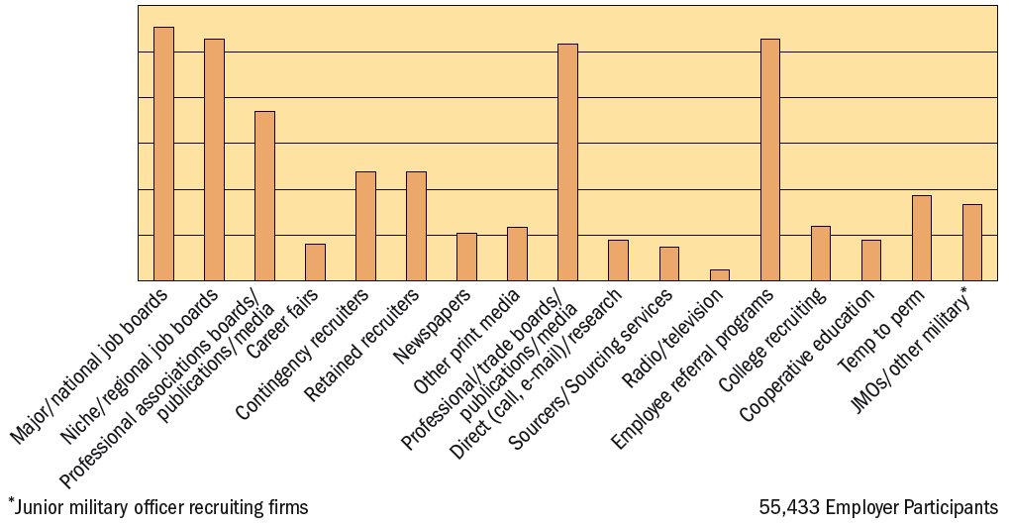
FIGURE 5–11 Relative Recruiting Source Effectiveness Based on New Hires
Copyright © 2011 Pearson Education
5–<number>
Notes:
Human Resources Management 12e
Gary Dessler
Copyright © 2011 Pearson Education
5–<number>
Figure 5-11 summarizes a survey of best recruiting sources. Internet job boards garnered the most votes, followed by professional/trade job boards and employee referral programs.

Slide 43

TABLE 5–1 Recruitment Research Findings: Practical Applications for Managers
Recruitment Research Finding | Practical Applications for Managers
The recruitment source affects the characteristics of applicants you attract. | Use sources such as referrals from current employees that yield applicants more likely to be better performers.
Recruitment materials have a more positive impact if they contain more specific information. | Provide applicants with information on aspects of the job that are important to them, such as salary, location, and diversity.
Organizational image influences applicants’ initial reactions. | Ensure all communications regarding an organization provide a positive message regarding the attractiveness of the organization as a place to work.
Applicants with a greater number of job opportunities are more attentive to early recruitment activities. | Ensure initial recruitment activities (e.g., Web site, brochure, on-campus recruiting) are attractive to candidates.
Realistic job previews that highlight both the advantages and the disadvantages of the job reduce subsequent turnover. | Provide applicants with a realistic picture of the job and organization, not just the positives.
Applicants will infer (perhaps erroneous) information about the job and company if the information is not clearly provided by the company. | Provide clear, specific, and complete information in recruitment materials so that applicants do not make erroneous inferences about the job or the employer.
Recruiter warmth has a large and positive effect on applicants’ decisions to accept a job. | Choose individuals who have contact with applicants for their interpersonal skills.
Copyright © 2011 Pearson Education
5–<number>
Notes:
Human Resources Management 12e
Gary Dessler
Copyright © 2011 Pearson Education
5–<number>
Table 5-1 lists research findings that reveal several guidelines employers can use to improve their recruiting efforts’ effectiveness.

Slide 44
Improving Productivity Through HRIS:
An Integrated Approach to Recruiting
Elements of an HRIS
Requisition management system
Recruiting solution
Screening services
Hiring management
Copyright © 2011 Pearson Education
5–<number>
Notes:
Human Resources Management 12e
Gary Dessler
Copyright © 2011 Pearson Education
5–<number>
Some employers have separate tools or systems for each element. However, several ATS providers integrate these elements into one comprehensive employee recruitment system.

Slide 45
Recruiting A More Diverse Workforce
Single parents
The disabled
Older workers
Welfare-to-work
Minorities and women
Copyright © 2011 Pearson Education
5–<number>
Notes:
Human Resources Management 12e
Gary Dessler
Copyright © 2011 Pearson Education
5–<number>
Recruiting a diverse workforce isn’t just socially responsible. Given globalization and the rapid increase in minority, older worker, and women candidates, it is a necessity.

Slide 46
Developing and Using Application Forms
Uses of Application Form Information
Applicant’s education and experience
Applicant’s
prior progress and growth
Applicant’s employment stability
Applicant’s likelihood of success
Copyright © 2011 Pearson Education
5–<number>
Notes:
Human Resources Management 12e
Gary Dessler
Copyright © 2011 Pearson Education
5–<number>
With a pool of applicants, the prescreening process can begin. The application form is usually the first step in this process (some firms first require a brief, prescreening interview or online test). A filled-in application provides four types of information listed in the slide.

Slide 47

FIGURE 5–12 FBI Employment Application
Copyright © 2011 Pearson Education
5–<number>
Notes:
Human Resources Management 12e
Gary Dessler
Copyright © 2011 Pearson Education
5–<number>
Figure 5-12 presents one employer’s approach to collecting application form information—the employment application for the FBI. In practice, most employers encourage online applications.

Slide 48
Application Forms and the Law
Educational achievements
Housing arrangements
Arrest
record
Areas of Personal Information
Marital
status
Notification in case of emergency
Physical
handicaps
Membership in organizations
Copyright © 2011 Pearson Education
5–<number>
Notes:
Human Resources Management 12e
Gary Dessler
Copyright © 2011 Pearson Education
5–<number>
Carefully review application forms to ensure that they comply with equal employment opportunity laws in the proper use of questions that the applicant is asked to answer.

Slide 49
Two-Stage Process
Is Applicant
Qualified?
Yes
Conditional
Job Offer
Review application information, personal interview, testing, and
do background check
Make conditional job offer contingent on meeting all “second stage” conditions
Copyright © 2011 Pearson Education
5–<number>
Notes:
Human Resources Management 12e
Gary Dessler
Copyright © 2011 Pearson Education
5–<number>
In choosing what to ask on the application, some experts suggest using a two-stage process. Ascertain the applicant qualification for the job, and then make a conditional job offer.

Slide 50
FIGURE 5–13 Sample Acceptable Questions Once Conditional Offer Is Made
Do you have any responsibilities that conflict with the job vacancy?
How long have you lived at your present address?
Do you have any relatives working for this company?
Do you have any physical defects that would prevent you from performing certain jobs where, to your knowledge, vacancies exist?
Do you have adequate means of transportation to get to work?
Have you had any major illness (treated or untreated) in the past 10 years?
Have you ever been convicted of a felony or do you have a history of being a violent person? (This is a very important question to avoid a negligent hiring or retention charge.)
What is your educational background? (The information required here would depend on the job-related requirements of the position.)
Copyright © 2011 Pearson Education
5–<number>
Notes:
Human Resources Management 12e
Gary Dessler
Copyright © 2011 Pearson Education
5–<number>
You may ask acceptable conditional job offer questions like those in Figure 5-13 once the candidate has passed the “second stage” conditions of the conditional job offer.

Slide 51
K E Y T E R M S
employment (or personnel) planning
trend analysis
ratio analysis
scatter plot
qualifications (or skills) inventories
personnel replacement charts
position replacement card
employee recruiting
recruiting yield pyramid
job posting
succession planning
applicant tracking systems
alternative staffing
on-demand recruiting services (ODRS)
college recruiting
application form
Copyright © 2011 Pearson Education
5–<number>
Notes:
Human Resources Management 12e
Gary Dessler
Copyright © 2011 Pearson Education
5–<number>

Slide 52

All rights reserved. No part of this publication may be reproduced, stored in a retrieval system, or transmitted, in any form or by any means, electronic, mechanical, photocopying, recording, or otherwise, without the prior written permission of the publisher. Printed in the United States of America.
Copyright © 2011 Pearson Education
5–<number>
Notes:
Human Resources Management 12e
Gary Dessler
Copyright © 2011 Pearson Education
5–<number>

